Slide 1
Methodology Airbnb NYC
Made By : Anurag Aditya & Pragyan Seth

Slide 2
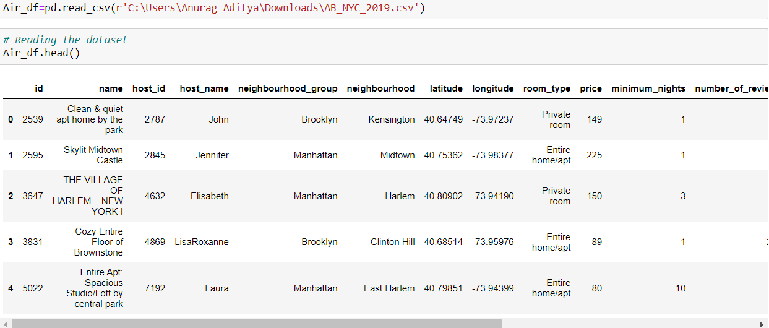
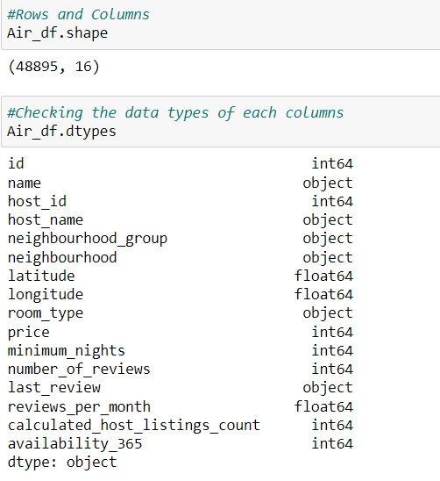
Exploratory Data Analysis
For data analysis we have chose Python as the tool we have loaded the data set (first image) in Python and found the shape (second image) of the data set which is 48895 as rows and 16 as columns

Slide 3
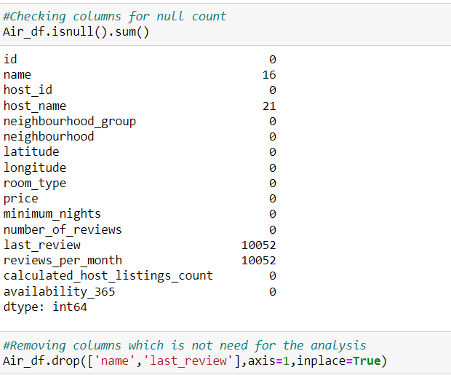
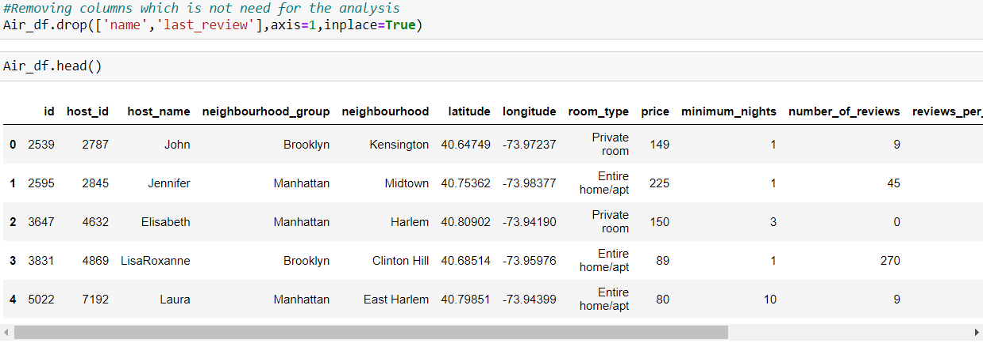
Exploratory Data Analysis
We are checking for the null values in the columns in first image and found the null columns as (‘id’, ’host_name’, ’last_review’, ’reviews_per_month’) and on the second image we have dropped the column which we do not need for our analysis which (‘name’ , ‘last_review’)

Slide 4
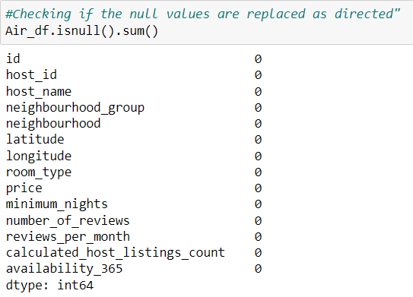
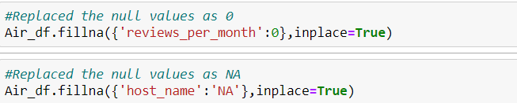
Exploratory Data Analysis
In first Image we have replaced the null values in columns where we have found null values. In ‘review_per_month’ we have replaced it with 0 and for the column ‘host_name’ we have replaced in with ‘NA’. In second image we again checked post replacing the null values it is executed correctly.

Slide 5
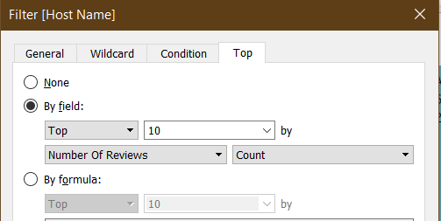
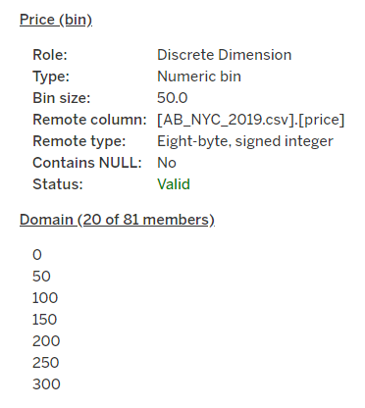
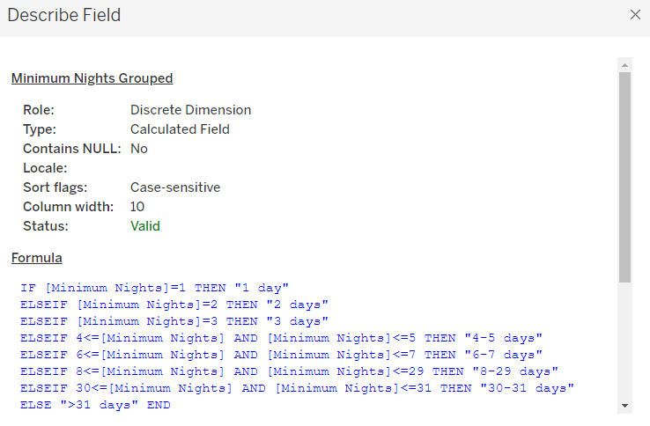
The visualization part is done in TABLEAU :
For Top 10 host the analysis was done basis count of number of rows.
To do the analysis on minimum nights and price bins, the bins were created

Slide 6
PPT -1
Airbnb listings spread in NYC
We have created a horizontal bars with percent of total of count of id and neighbourhood groups in colour mark card.
2. Most preferred neighborhood groups
We created a pie chart for understanding the percentage of bookings done in neighbourhood groups.
We added neighbourhood groups to the colours mark card and count of Id to the size
3. Room type most preferred by customer
We created a pie chart for understanding the percentage of room type preferred w r t neighbourhood group
We added Room Type to the colours Marks card to highlight the different Room Type in different colours and count of Id to the size

Slide 7
4. Average Neighbourhood group price
We created a bubble chart with Neighbourhood Groups in Columns and Price column in Rows.
We added the Neighbourhood Groups to the colors Marks card to highlight the different neighbourhood Groups in different colors. Also Put Avg price in Label.
5. Room type percentage basis Neighbourhood:
We have created a side by side bars to check the percentage of booking done wrt to room type and the Neighbourhood groups. The quick table calculation was done on count of Id column kept as across
6. Top 10 hosts basis reviews:
We have created a top 10 filter on Host Name basis count of number of reviews.

Slide 8
7. Minimum nights booked basis room type
We have created a bins with help of calculated field.
The bins were used to display the distribution of minimum nights based on the amount of ids booked for each neighbourhood group.

Slide 9
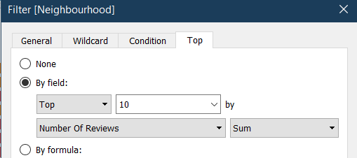
8. Popular Neighbourhood basis reviews
We have created a top 10 filter on Neighbourhood basis sum of number of reviews and kept Neighbourhood in color marks card and sum of number of review in label marks card.
9. Neighbourhood vs Availability
We created a dual axis chart using bar chart for availability 365 and line chart for price for top 10 neighbourhood group sorted by price and synchronized the axis accordingly.

Slide 10
PPT -2
1. Price variation basis geography
We used Geo location chart to plot neighbourhood , neighbourhood Group in map to show case the variation of prices across.
2. Price range preferred by Customers
We have created a bins of price with bin size as 50 as to analyze the price range preferred by the customer
3. Preferred Room type w.r.t Neighbourhood group
We created Highlight Table chat by taking Room Type & Neighbourhood Group in rows and count of Id in column.
We took the neighbourhood groups in colour Marks card to check the booking percentage of room type wrt neighbourhood groups.

Slide 11
4. Popular Neighborhoods:
We took neighbourhood in rows and sum of reviews in column and took neighbourhood groups in colour.
We used filter to show Top 10 neighbours as per the sum of reviews
We used Geo location chart to plot neighbourhood , neighbourhood Group in map to show case the variation of prices across.

Slide 12
END Thank You

